Slide 1
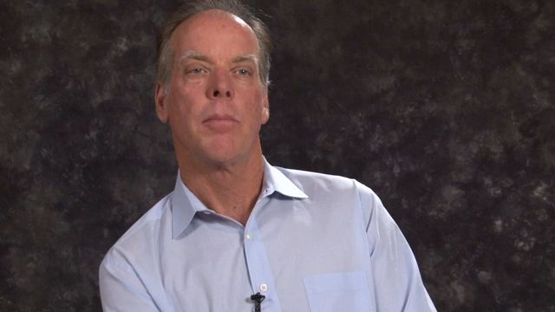
OVERCOMING BARRIERS
Rethinking Parent Child Contact Problems in Post Separation Families
Hear Dr Matt Sullivan, OCB Advisory Council
member and Co-Founder

